Slide 1
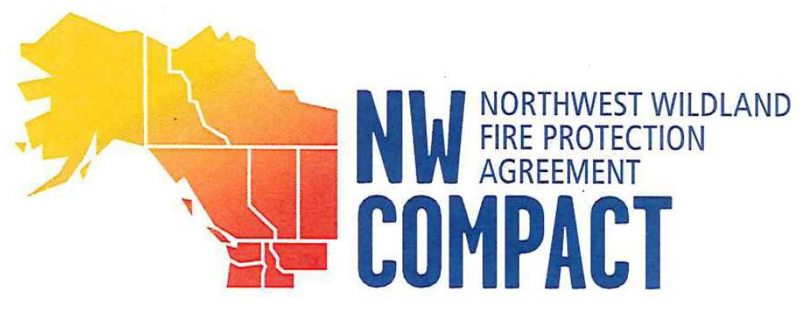
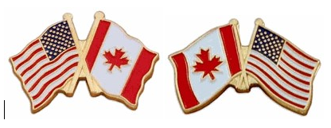
2023 Alaska Interagency Incident Business Training
AK DNR – Andrea Fruean & Heidi Scott / Tanana Chiefs Conference – Jolene Bante

Slide 2
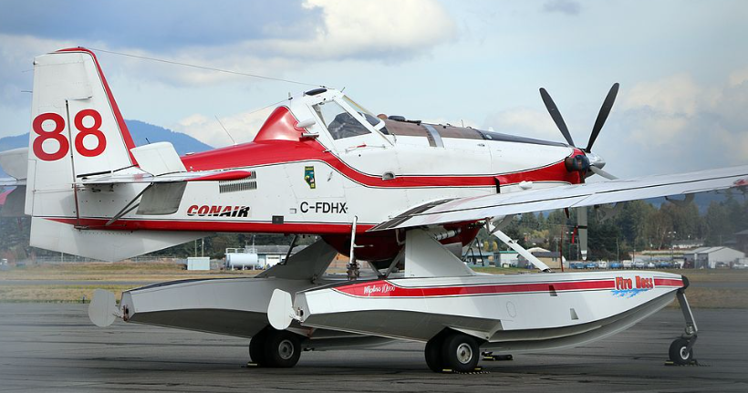
What is the Northwest Compact?
an agreement that allows participating cooperators to share resources.
Shared resources assist in prevention, preparedness, prescribed fire, training, pre-suppression, and suppression control.
Requests for resources can be filled in as little as 48 hours.
Notes:
The Northwest Wildland Fire Protection Agreement – the Northwest Compact – is an operational plan.
The agreement is governed by an “act” that was signed into law by Congress in 1998. The purpose is to help member agencies acquire wildland firefighting resources when they need them most.
This picture is a Canadian Air Tanker, as known as an “Air Boss” or “Duck” which is an amphibious aircraft that has “scooping” functionality. Typically the air bosses travel is a fleet of 5 aircraft.

Slide 3
Who are the Parties of the NWC?
5 Canadian Provinces
The Yukon Territory
The Province of British Columbia
The Province of Alberta
The Province of Saskatchewan
Alaska Department of Natural Resources, Division of Forestry & Fire Protection
Idaho Department of Lands
Montana Department of Natural Resources
Oregon Department of Forestry
Washington Department of Natural Resources
5 United States
The Northwest Territories
Notes:
The states listed above are the only states that can direct bill the State of Alaska. Non-participating states bill through the US Forest Service or the BLM as the “clearing house”. The BLM/USFS in turn bill the State of Alaska through the cross-billing process.

Slide 4
Authority
The Northwest Wildland Fire Protection Agreement ratified by US Public Law 105377, 1998, and signed by the member agencies provides for this cooperative operating plan under Article 3.2.
AK DNR Statewide Operations Chief is the lead point of contact and therefore analyzes the current fire climate and can request resources with a simple phone call to partnering provinces/states.

Slide 5
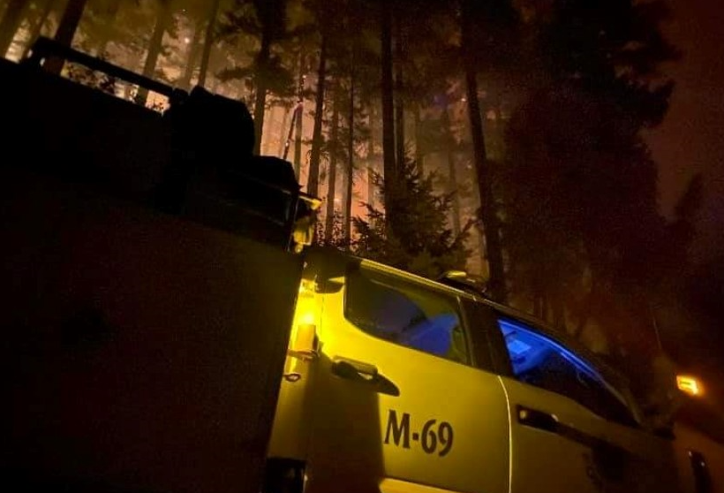
Administrative Benefits & Challenges
BENEFITS
Requests for resources are channeled by the most expeditious means to the appropriate authorized officials.
Sharing of resources allows for adequate staffing in Alaska, the lower 48, and in Canada.
CHALLENGES
Canadian resources must be forced into IROC.
Additional processes are necessary to track resources.
Notes:
This picture is of the State of Alaska’s engine strike team in OR/WA during the 2021 fire season. This was the first year that we began sharing our engines with the lower 48. The division plans to continue sharing the engine strike teams with our partners in the South.

Slide 6
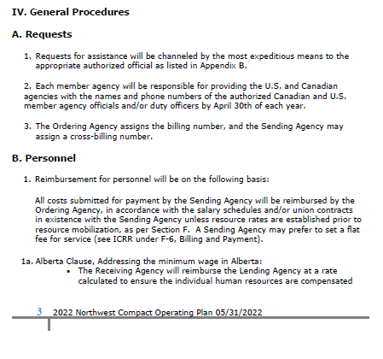
General Procedures
General procedures outlined in the agreement are intentionally vague.
Notes:
All parties work together to support each other in time of dire need of resources.
The document includes the contact and approving personnel for each participating agency.
The agreement outlines personnel, equipment and supplies, aircraft
The agreement details how each party will bill for reimbursement, when resources are sent out of area.

Slide 7
NWC Overview
If receiving NWC resources, review the agreement for specific processing guidelines.
It’s important to note that the Canadian provinces bill the US in CAD and the US bills in USD.
Must use the Bank of Canada for conversion.
Administrative and financial representatives have begun meeting to ensure processes are consistent within each state/province.
State of Alaska contacts:
Ed Sanford – operations
Heidi Scott – financial and administration
Katie Kelley – dispatch and ordering
Notes:
All parties work together to support each other in time of dire need of resources.
The document includes the contact and approving personnel for each participating agency.
The agreement outlines personnel, equipment and supplies, aircraft
The agreement details how each party will bill for reimbursement, when resources are sent out of area.
Operational representatives from each cooperating party meet annually to discuss and edit the operating agreement.

Slide 8
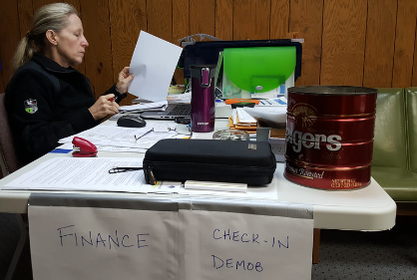
How the Finance Section processes NWC Resources
NWC personnel resources are processed in the same manner as other resource going to a fire.
Must check-in
Must have a RO assigning them to the fire
Complete CTRs and receive an OF-288.
State of Alaska Agency Equipment – Require an OF-286
Review the RO for type of equipment (Ex Type 6 Engine)
Vendor agreement address is in NW Compact Appendix C
Rate will come out of the Region’s Geo. Area Supplement
Notes:
State of Alaska engines and personnel will continue to support the lower 48 and Canada. State of Alaska is working on documenting the process for tracking the strike teams.

Slide 9
What Would You Do? Scenario One
The State of Alaska engine strike team is assigned to an incident in Washington;
Where is the agreement for the strike team located?
Where can you find the rates for the engines?
How are the staff that accompanied the engines (as operators) processed?

Slide 10
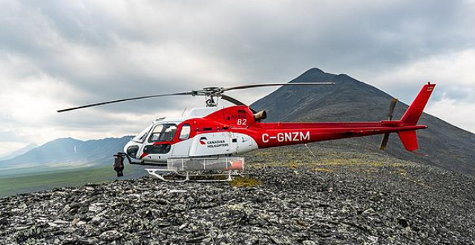
What Would You Do? Scenario 2
A NWC Canadian helicopter arrives at a fire to check-in;
The helicopter and staff are on a NWC Preposition resource order.
Can they use that resource order and begin working on the fire?
Why? Why not? What should happen?

